Slide 1
Chapter 1
The Architecture of
8086

Slide 2
Introduction
Need to know the learning of x86 family of microprocessors
Understand the architecture of the 8086
8086 is a processor catering to 16-bit data (D0 to D15) and having a 20-bit address (A0 to A19)
8086 is a 16-bit processor internally & externally
means its data bus width as well as the bit size of its internal data registers is 16
it can even access external source 16 bits
it also has the capacity to access and work on 8-bit data.

Slide 3
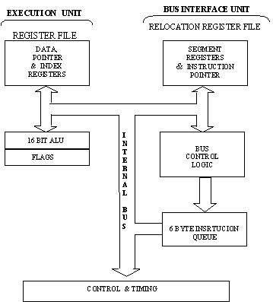
Block Diagram

Slide 4
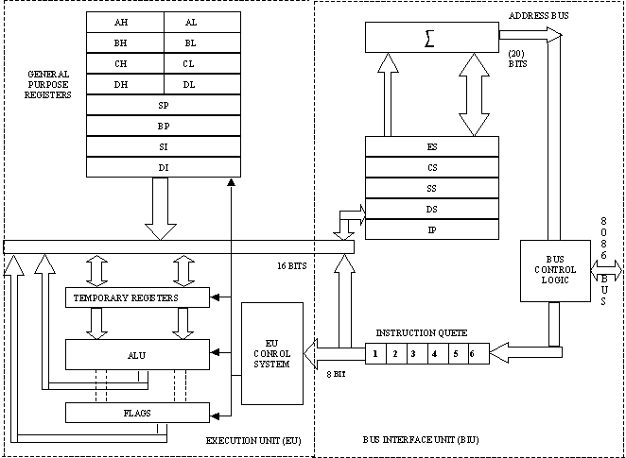

Slide 5
8086
Units of 8086 are:
The Execution unit
The Bus Interface unit

Slide 6
Execution Unit
It mainly Contains
Arithmetic and Logic Unit
The Control Unit
Internal Bus
few Registers

Slide 7
EU starting with registers
All processors have internals registers
It is actually an on-chip RAM
Programs on these are few visible and others are not directly visible
Internal registers are used as temporary storage for operands
if the operand is already in the register, it takes less time for execution of the associated instruction.
Such registers are called General purpose OR Scratch pad registers.
How the register set of 8086 has been organized?

Slide 8
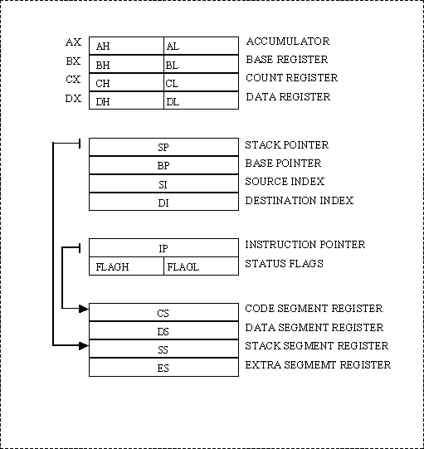
Register Model of the 8086

Slide 9
The scratch pad registers
AX (16 bits) -AH and AL (each 8 bit)
BX (16 bits)--BH and BL (each 8 bit)
CX (16 bits) --CH and CL (each 8 bit)
DX (16 bits) --DH and DL (each 8 bit)

Slide 10
Pointer and Index Registers
DI –destination index – for string operations
SI - source index – for string operations
SP -stack pointer –for accessing stack top
BP –base pointer –for accessing any location in stack
IP –instruction pointer-points to the next instruction to be executed

Slide 11
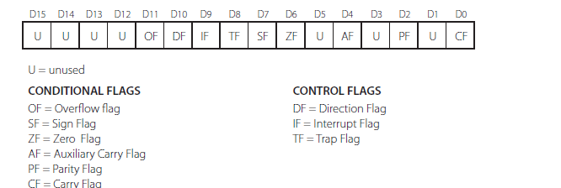
FLAG REGISTERS

Slide 12
It is a 16-Bit register of which 7 bits are unused
Of remaining, 6 bits are used as conditional flags
Others are control flags
Conditional flag is a single-bit flip-flop which is set or reset according to the results of an ALU
CONDITIONAL FLAGS CONTROL FLAGS
OF= Overflow flag DF= Direction Flag
SF= Sign Flag IF= Interrupt Flag
ZF= Zero Flag TF= Trap Flag
AF= Auxiliary carry Flag
PF= Parity Flag
CF= Carry Flag

Slide 13
Carry Flag (CF): This flag gets enabled, if there is a carry out from the most significant bit (MSB) during calculation. Ex: for 8-bit addition, carry out from the MSB D7 and for 16 bit operation MSB is D15
Zero Flag (ZF): When the result of an arithmetic or logic operations is zero, the zero flag gets set. Like Comparision, count etc..
Parity Flag (PF): The setting of the flag indicates the presence of even number of ‘1’ bits in the LSB of the destination. Like particular arithmetic operations, it works only on lower 8-bit even for 16-bit data. It finds not much application in current programming.
Sign Flag (SF): After arithmetic or logical operation, if the result contains a negative number, this flag is set.
Auxiliary Flag (AF): is similar to carry flag, except that the overflow is from bit D3 to D4. It thus indicates a carry from the lower 4 bits. The need of this flag is for the DAA, in BCD.

Slide 14
Overflow Flag (OF) : This flag is set under one of the following conditions
1. there is an overflow into MSB (8th or 16th Bit) from the bit of lower significance, but no carry out from the MSB.
2. there is a carry out from the MSB, but no carry into the MSB.
The control flags like Trap Flag (TF) is set to perform step-by-step execution during debugging.
The Interrupt flag (IF) is set to enable interrupts.
The direction flag (DF) is used in string operations.

Slide 15
1.3 Bus Interface Unit
This unit is responsible for
Address Calculations
pre-fetching instructions for the queue and sequencing instructions one by one.

Slide 16
1.3.1 Instruction Queue
Instructions are found in memory
From there it has to be fetched & decoded whenever needed for execution.
in 8086, the queue that fetches instructions ahead of execution time & places them in a 6-byte FIFO queue
This pre-fetching is done when buses are free
Advantage of this is when a particular instruction needs to be executed, it’s a good chance of finding in a queue rather than from memory

Slide 17
1.3.2 Memory Segmentation
8086 has a 20-Bit address bus ( As we have not seen any 20- Bit regsters so far)
general-purpose registers are used as 16 or 8 bit registers
all address registers also are16-bit
Segmentation will be used to take care of this situation
A segment is just an area in memory
so total memory size can be considered to be divided into segments of various sizes.
Idea of dividing memory is called Segmentation
In memory data is stored as bytes
Each byte has a specific address
with 20 address lines, the memory that can be addressed is 220 bytes (1,048,576 Bytes or 1 MB)
8086 can access a physical memory with address ranging from 00000 to FFFFFH.

Slide 18
20-bit physical address is to be placed on the address bus to access any location in memory.
Memory as a whole is considered to have four different types of segments:
1. data segment
2. code segment
3. stack segment
4. extra segment
Idea of segmentation is to keep data & code separately
code segment contains code only
data is stored in the data segment
extra segment is just another type of data segment used in special way
stack segment is an area in memory which functions and is accessed from the other three segments

Slide 19
1.3.2.1 Segment Registers
Each segments is addressed by an address stored in corresponding segment registers
registers are all 16-bit size
each register stores base address of the corresponding segment
Base address is the starting address of a segment
since segment registers cannot store 20 bits, they store only the upper 16 bits
least significant nibble is implied to zero
How 20 bit physical address obtained if there are only 16 bit registers?
20 bit address of a byte is called Physical address
it is specified as Logical address in the form of two16-bit numbers in the format base address : offset

Slide 20
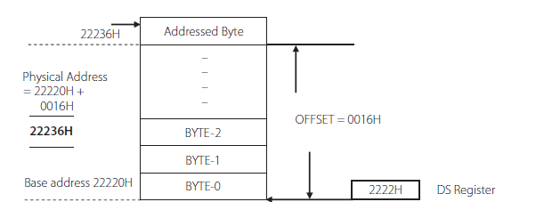
Example: Calculation of a physical address from the logical address for a data segment

Slide 21
Consider that a data byte is stored in a data segment, whose base address is 22220H
Then data segment register will contain the number 2222H.
The data at any location within this segment is referred to an offset with respect to the base address.
If a data at a location has a logical address specified as 2222H:0016H
Then the number 0016H is the offset or displacement w.r.t the base address
For physical address calculation, the BIU appends the segment register content with four binary zeros on the right.
Thus physical address is calculated as:
22220H
+ 0016H
22236H

Slide 22
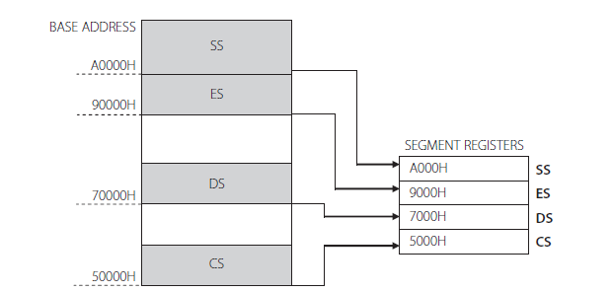
Similar in case for the other segments
offsets are limited to 16Bits
means that the maximum size possible for a segment is only 216 or 64KB
Hence every memory reference by the 8086 will use one of the segment registers (i.e DS, ES, SS, or CS)
combined to form an offset to determine the physical address being accessed.
Fig that highlights a data byte that has the logical address of the form DS: Offset.

Slide 23
1.3.2.2 Code Segment & Instruction Pointer
Code segment is the area of memory where code alone is stored.
offsets in the code segment are referenced by Instruction Pointer. ( a 16-Bit register)
IP sequences the instructions and points to the next instruction to be executed.
If an instruction byte has to be fetched from memory, the bus interface unit performs the address calculation using the contents of CS registers & the IP
This 20-bit address is then placed on the address bus and the instruction byte is fetched.
Hence the logical address for an instruction is of the form CS:IP

Slide 24
1.3.2.3 Stack Segment and Stack Pointer
Stack is an area in memory and data is generally pushed & popped out of the stack
8086 also uses LIFO stack
There is a 16-Bit register called Stack Pointer, which points to the top of the stack
Stack segment is like other segment
upper 16 bits of its base address is available in the SS register
A stack address of the form 4466H: 0122H means that the SS register contains 4466H
stack pointer contains the number 0122H
So the physical address of the top of the stack is
44660H + 0122H = 44782H

Slide 25
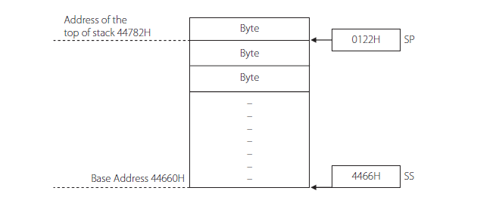

Slide 26
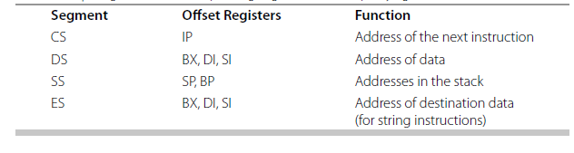
1.3.2.4 Data Segment and Extra Segment
Both segments store data
Extra segment register to store the upper 16 bits of the base address of the extra segment.
offset within the data segment is also termed as ‘ effective address’
effective address calculations depends on effect of mode of answering.
Table shows the segment registers and the corresponding registers that can be used for offsets

Slide 27

Advantages of Segmentation
All address registers are only 16 bit long, though the physical address is 20 bits
All address are re-locatable
Memory organization in little-endian format

Slide 28
1.4 Addressing Modes
In order for computations in assembly language, we need an Opcode & Operands
Opcode stands for Operation Code
Opcode specifies the operation to be performed
Opcodes operate on data, which are called the Operands
The way in which operands are specified in an assembly language is called its “Addressing Mode”.
Operands can be in registers, in memory or may be in the instruction itself.
in case of two operands, one of them can be in memory, but the other will have to be placed in a register
data types should match, that is, source, and destination should both be either bytes or words

Slide 29
1.4.1 Register Addressing
Here both source and destination are registers. No memory access are involved.
MOV AL, AH ; copy the content of AH to AL
MOV CH, BL ; copy the content of BL to CH
MOV SI, BX ; copy the content of BX to SI
MOV ES,AX ; copy the content of AX to ES
Note that the first two are byte operations, while the other two are word operations.
MOV AX, BL ; gives error as AX is 16 bit & BL is 8 bit
MOV BL, AX ; gives an error for the same reasons

Slide 30
1.4.2 Immediate Addressing
Here source will be a constant data
MOV AL, 45H ; copy 45H to AL
MOV BX, 34E3H ; move the hex number 34E3H to BX
MOV CL,’Q’ ; move the ASCII value of Q to CL
MOV PRICE,40 ; move the hex num 40 to the memory location with the label PRICE
MOV NUMS, 0FC6H ; move the hex number 0FC6H to the memory location NUMS
Segment registers are not allowed to use this mode of addressing
MOV DS,2300H ; gives an error as DS is a segment register

Slide 31
1.4.3 Direct Addressing
Here, either the source or the destination will be a memory address
MOV AX, [2345H] ; move word location 2345H to AX
MOV [1089H], AL ; the byte in AL is moved to location 1089H
MOV AX , PRICE
MOV COST,AL
PRICE and COST are labels for memory addresses

Slide 32
1.4.4Register Indirect Addressing
In this mode , the address of the data is held in a register
Effective address
EA=EA= { [BX] / [DI] /[SI]}
MOV AL,[BX] ; move into AL the content of the location whose address is in BX
MOV [SI], CL ;move the content of CL to the address pointed by SI
MOV [DI],AX ; move the content of AX to the address pointed by DI
In third instruction, AX contains two bytes, so the content of AL will be moved to the address pointed by DI.
The content of AH will be moved to the address [D+1]

Slide 33
Example
Show the location of data in memory, after the execution of each of these instructions , if the content of registers are as given
DS= 1112H , AX= EE78H and BX=3400H
MOV [0422H], AL
MOV [0424H],AX
MOV [BX] ,AX

Slide 34
1.4.5 Register relative addressing
In relative addressing mode , a number or displacement is part of the effective address
EA ={[BX] /[DI] /[SI] /[BP]} + 8 bit or 16 bit displacement
The displacement can be a 16 bit signed/unsigned number or an 8 bit sign extended number.
MOV CL ,10[BX] ; move the content of the address specified by adding the content of BX and 10
Like
MOV CL, [BX+10]
MOV CL, [BX]+10

Slide 35
1.4.6 Based Indexed Mode
In this mode ,an index register and a base register together carry the effective address .
The content of these two registers are added and called the effective address.
MOV AL,[BX][SI] ; move the content of the effective address pointed by [BX] and [SI] into AL
MOV [BX][DI],CX ;move the content of CX to the effective address pointed by [BX] and [DI]

Slide 36
1.4.7 Relative Based Indexed Mode
The ‘effective address is the sum of the two registers and a displacement .
MOV DL ,5[BX][DI]
MOV 5[BP][SI], AX
MOV CL ,COST[BX[[SI]

Slide 37
Example
Find the address of physical memory for the following instructions if the content of the required registers are as given below
SS =2344 H, DS =4022H ,
BX =0200H,BP=1402H ,SI=4442H
i)MOV CL,1234H[SI]
i)MOV AL,5[SI[[BP]

Slide 38
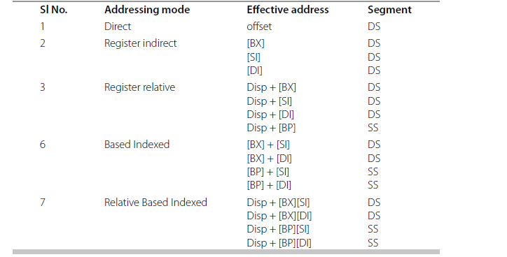
Effective Address and Referred Segments for Various Memory Based Addressing Modes

